Slide 1
Windows Memory Management

Slide 2
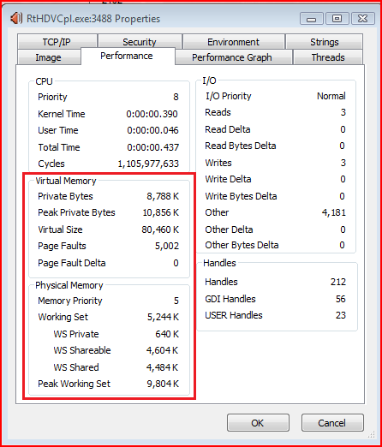
Question1
Properties in Process Explorer

Slide 3
Question2
Total memory:
(Get-Process | Measure-Object -Property VirtualMemorySize64 -Sum).Sum / 1GB
Around 4.3GB in my PC
Physical memory: 3.3G
What’s extra 1G?

Slide 4
Agenda
Virtual Address Space
Physical Storage
Heap

Slide 5
Virtual Address Space
Virtual Address Space
4G: 2³²
Every process has its own PRIVATE address space
Structure
Partition
Region
Block

Slide 6
Partitions in Virtual Address Space
Partition | Address | Objective
NULL-pointer assignment | 0x00000000 0x0000FFFF | Help programmers catch NULL-pointer assignments
User-mode | 0x00001000 0x7FFEFFFF | Process’ address space resides Private space for each process
64-KB Off-Limits | 0x7FFF0000 0x7FFFFFFF | Guard space
Kernel-Mode | 0x80000000 0xFFFFFFFF | Operating system’s code resides Shared by all processes

Slide 7
Regions in Virtual Address Space
Reserve a range of address
Reserved memory
Granularity boundary: 64-KB
Start address: rounded to a 64-KB boundary
Size: rounded up to a multiple of the page size
Page size: 4 KB

Slide 8
Blocks in Virtual Address Space
Commit physical storage
Committed memory
Granularity boundary: page size
Start address: rounded to a 4-KB boundary
Size: rounded up to a multiple of the page size
Page size: 4 KB

Slide 9
Physical Storage
Memory
Page File
Memory-Mapped Files

Slide 10
Concepts in Physical Storage
Virtual Size
Reserved memory
Private Bytes
Committed memory
Working Set
Physical memory
Virtual Size > Private Bytes > Working Set
Question: What is out of memory?

Slide 11
DEMO1
VirtualAllocDemo

Slide 12
Memory in Physical Storage
Fast
Expensive
Shared by all processes

Slide 13
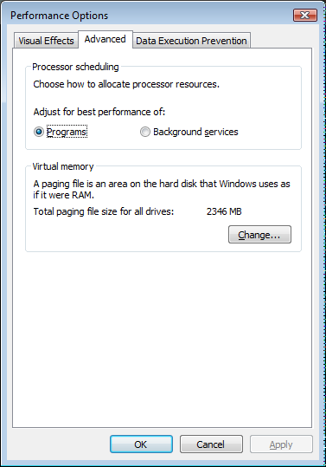
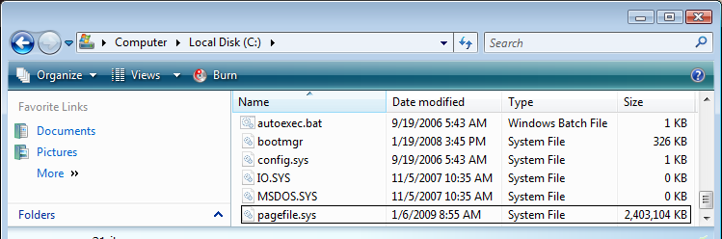
Page File in Physical Storage
Slow
Cheap
Shared by all processes
Inswap & Outswap

Slide 14
Memory-Mapped Files in Physical Storage
Treat FILE as MEMORY
Enabled by SEH
Used by operating system widely
Executable file
DLL file
WriteCopy
Rebase

Slide 15
DEMO2
WindowsMemoryManagement

Slide 16
Heap
PROS
For small data structure
Productive
Ignore allocation granularity and page boundary
CONS
Slow
Loss of detail control
HeapAlloc vs. malloc vs. new
Notes:
HeapAlloc is a function forwarder in Windows Vista. It is forwarded to ntdll!RtlReAllocateHeap.

Slide 17
Heap
new
malloc
HeapAlloc
VirtualAlloc
Notes:
A call to KERNEL32!HeapAlloc will be directed to NTDLL!RtlAllocateHeap.

Slide 18
DEMO3
MallocAndNew
Notes:
KERNEL32!HeapAlloc->NTDLL!RtlAllocateHeap

Slide 19
Heap
Win32 heap debugging facility
Heap free checking
User-mode stack trace
Heap tail check
…
Notes:
gflags -i HeapFreeChecking.exe +hfc
gflags -i HeapFreeChecking.exe –hfc
gflags -i MallocAndNew.exe +ust
umdh -pn:MallocAndNew.exe -d -f:u1.log –v
umdh -pn:MallocAndNew.exe -d -f:u2.log -v
umdh -d u1.log u2.log –v
gflags -i MallocAndNew.exe -ust
gflags /p /enable HeapTailChecking.exe
gflags /p /disable HeapTailChecking.exe
gflags /p /enable HeapTailChecking.exe /full

Slide 20
Heap
CRT Heap Debugging facility
{,,msvcr90d.dll}_lRequestCurr
CRT Allocation Hook
_CrtDumpMemoryLeaks()

Slide 21
References:
Windows via C/C++
VMMap from Sysinternals
Software Debugging
Inside CRT: Debug Heap Management

Slide 22
Q&A

